Slide 1
Deploy Virtual Machines in the Cloud Part II

Slide 2
Session objectives and takeaways
Learn how to maximize Azure Virtual Machines Service to power your cloud solutions including,
VM Fundamentals
Networking Fundamentals
Troubleshooting VMs
Azure Resource Manager & Templates

Slide 3
IaaS Fundamentals

Slide 4


Selecting the right VM size
Highest value
Largest scale-up
A
D
DV2
G
N
Highest value
SSD Storage
Fast CPUs
>80,000 IOPs
Premium Storage
New generation
of D family VMs
Most memory
fastest CPUs
GPU-enabled
virtual machines
35% faster than D
Intel E5-2673 v3 CPUs
NVIDIA GPUs
Remote visualization
Compute-intensive + RDMA

Slide 5

A-series family
Highest value VM size
General purpose
Higher memory options

Slide 6
The A family
A0 – A4
  Entry level VM sizes
  Basic and Standard sizes
  Local storage: Magnetic
  Standard_A0 – Standard_A4
  Basic_A0 – Basic_A4
  Higher Memory: Standard_A5 – Standard A7

Slide 7
The A family
A8 – A11
  High performance RDMA
  Higher performance CPUs
  Local storage: Magnetic
  Standard_A8 – Standard_A9
  Standard_A10 – Standard_A11

Slide 8
The Dv1 family
60% faster CPU than A-Series
Up to 112 GB memory
Local Storage: SSD storage (1x800GB)
Dv1

Slide 9
The Dv2 family
35% faster CPU than Dv1-Series
Up to 112 GB memory
Local Storage: SSD storage (1x800GB)
Dv2

Slide 10
The G family
Optimized for data workloads
Up to 32 “Haswell” CPU cores, 448 GB RAM, 6.5 TB local SSD
G

Slide 11
Storage options
Premium storage
  Optimized for low latency or high bandwidth
  Up to 64,000 IOPS and 64Gbps per storage account
  Billing based on provisioned size (not actual writes)
  Blobs only
Standard storage
  Optimized for general purpose storage
  Up to 20,000 IOPS and 20Gbps per storage account
  Billing based on actual bytes written to storage
  Blobs, Files, Tables, and Queues support
Premium
Standard

Slide 12
Premium Storage VMs
Standard_DS1 with 2 P30 Disks
Standard_DS1
Virtual Machine
DS
GS
Uncached
Disk
Cached
Disk
Local
Disk
Disk Provisioning
5k IOPS, 200MB/s
Disk Provisioning
5k IOPS, 200MB/s
SSD Provisioning
4k IOPS, 32MB/s
Cache Miss
Cache Hit
Server
SSD
VM/Network Provisioning
Up to 64 TB of storage per VM
80,000 IOPS per VM
5,000 IOPS per disk
~5ms read/write (no cache)
Less than 1ms read latency (cache)
3,200 IOPS, 32MB/s
Premium Storage Blobs

Slide 13
Optimizing storage performance
General Purpose Performance
Premium storage disks
Read-only caching
Database Logfiles
Premium storage disks
No caching
Standard Performance
Standard storage
No caching if >4 disks
Stripe for higher IOPS

Slide 14
Demo: Scaling up a VM

Slide 15
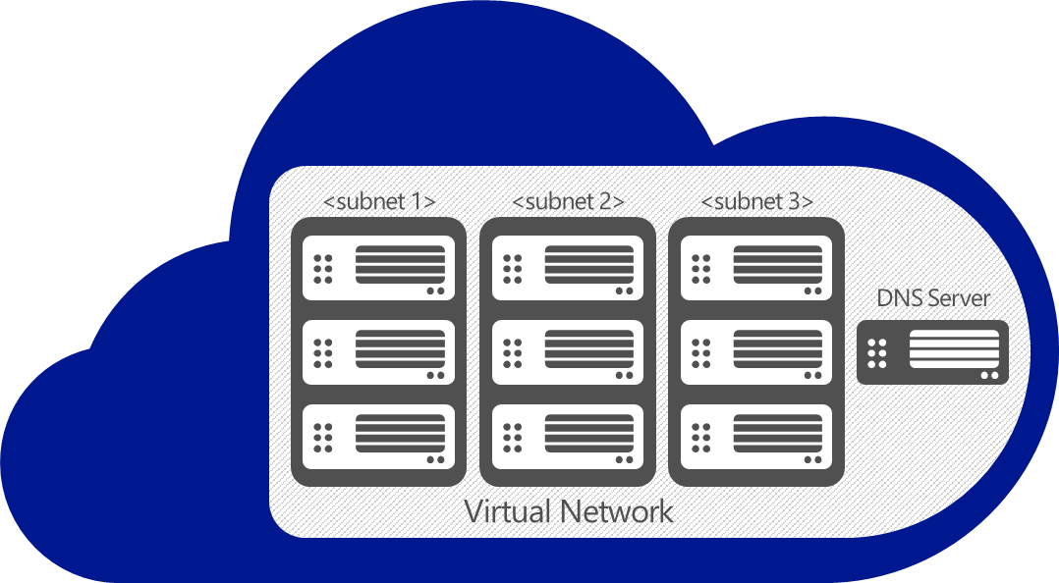
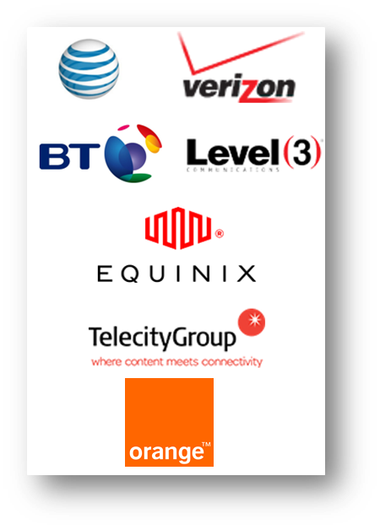
Hybrid Connectivity
Define Subnets, Private IPs, DNS
SSL Based Connectivity
VPN Device Connectivity
Partner ExpressRoute
GW
On-premises
VPN

Slide 16

Network Security
On Premises 10.0/16
Segment network for security
5 tuple ACLs on both directions
Protect internet and internal traffic
Enables DMZ subnets
Associated to subnets or VMs
ACLs can be updated independent of VMs
Internet
ExpressRoute
and VPNs
√
√
√
√
VPN GW
Backend
10.3/16
Mid-tier
10.2/16
Frontend
10.1/16
Virtual Network

Slide 17
Demo: Multi-region networks

Slide 18
Virtual Machine Availability Sets
Update Domains are honored by host OS updates
Fault Domain
Fault Domain
Rack
Rack
Availability Set
Virtual Machine
Virtual Machine
IIS1
IIS2
UD #2
UD #1
Availability Set
Virtual Machine
Virtual Machine
SQL1
SQL2
UD #1
UD #2

Slide 19
Demos:
HA Deployments
VM Troubleshooting

Slide 20
Azure Resource Manager

Slide 21
Resource Groups
Manage resources as a single unit
Role based access and control (RBAC) on groups or resources
Billing integrated tagging on groups or resources
RESOU
R
CE G
R
OUP

Slide 22
Access Control: RBAC
Role Definitions
Describes the set of permissions (e.g. read actions)
Can be used in multiple assignments
What is RBAC
Allows secure access with granular permissions to resources
Assignable to users, groups or service principals
Built-in roles make it easy to get started
Role Assignments
  Associate role definitions with an identity (e.g. user/group) at a scope (e.g. resource group)
  Always inherited – subscription assignments apply to all resources

Slide 23
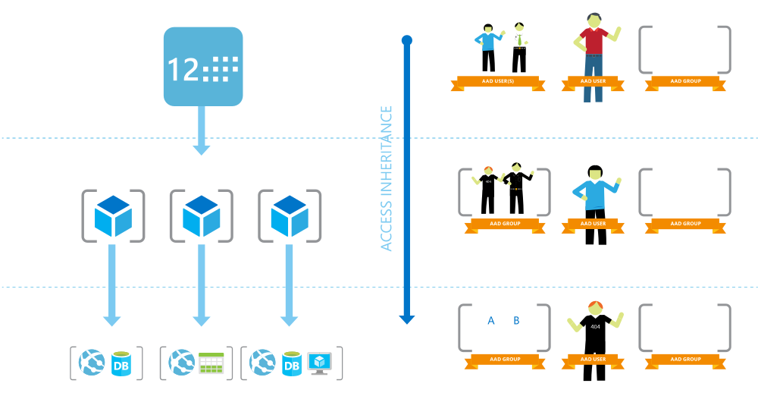
Role Based Access Control

Slide 24
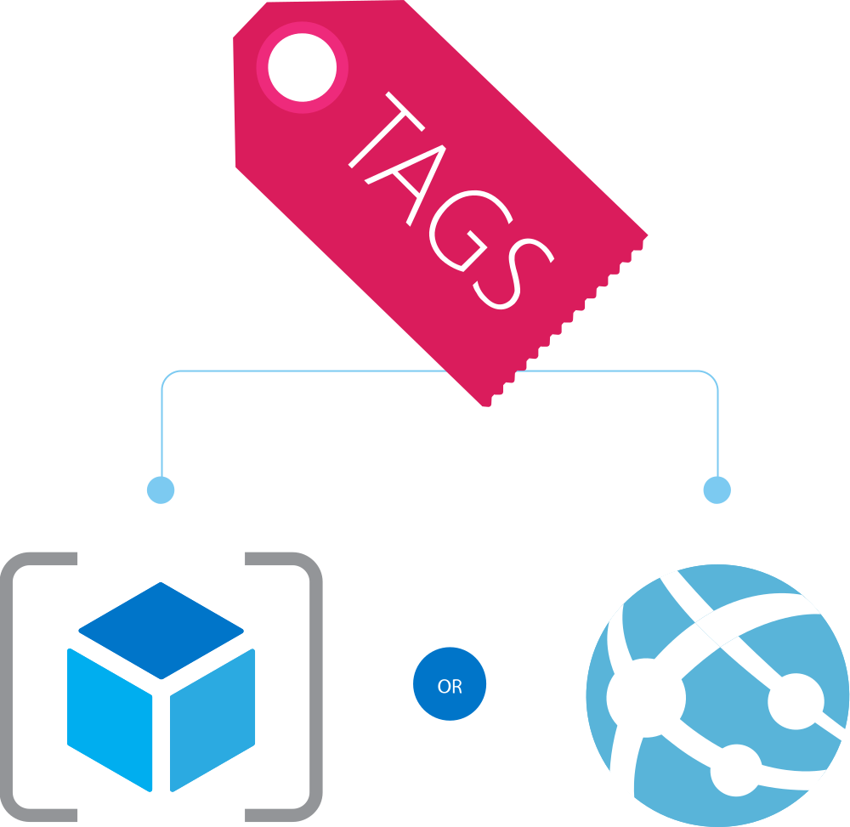
Resource Tags
Name-value pairs assigned to resources or groups
Subscription-wide taxonomy
Each resource can have up to 15 tags
Tagging Tips
Notes: Simple note for VM
Creator: track the “owner” of a VM
Department/Cost center: who pays
Environment: production vs. pre-production vs. test

Slide 25
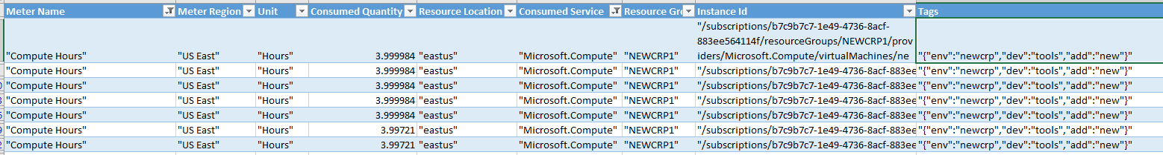
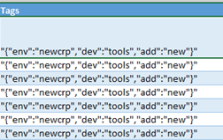
Tags and Billing Reports

Slide 26
Demo:
Using RBAC and Tags

Slide 27
Anatomy of a resource group
Subscription
ARM Template
JSON document
Describes each resource
Supports child deployments
Deployed to a Resource Group
Resource Group (MyGroup)
Resource (VNet)
Reference
Resource (NIC)
Resource (VM)
Resource (Public IP)
Resource (Load Balancer)

Slide 28
DataStax on Azure Virtual Machines
opscenter-resources.json
Parameters
storageAccountPrefix
dnsName
virtualNetworkName
adminUsername
adminPassword
region
opsCenterAdminPassword
clusterVmSize
clusterNodeCount
clusterName
opscenter-install-resources.json
azuredeploy.json
opscenter.sh
ephemeral-nodes-resources.json
dsenode.sh

Slide 29
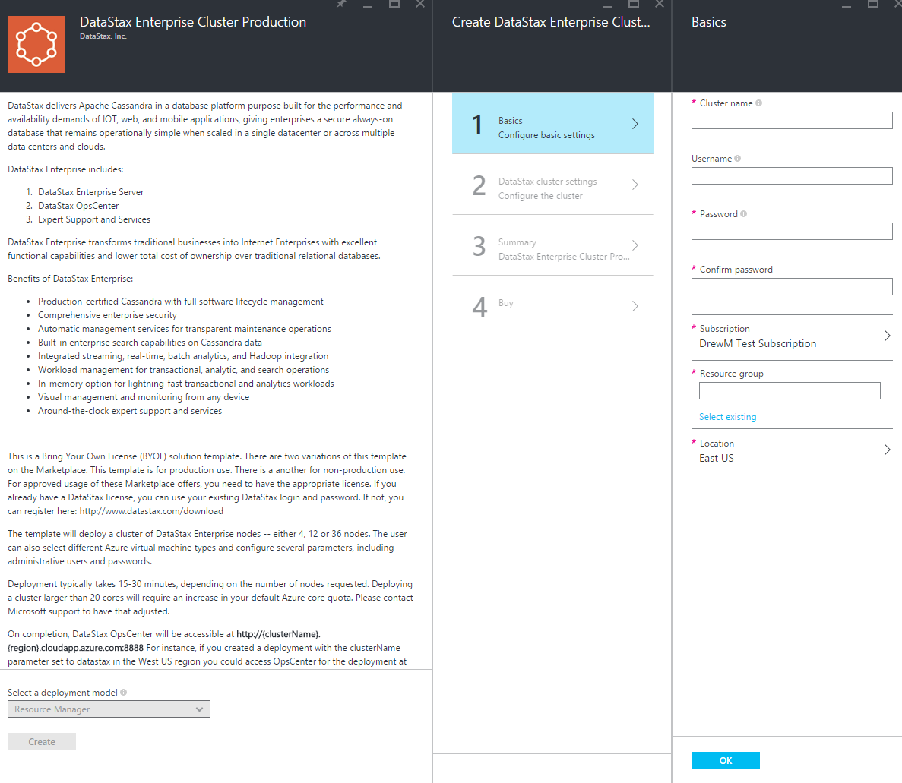
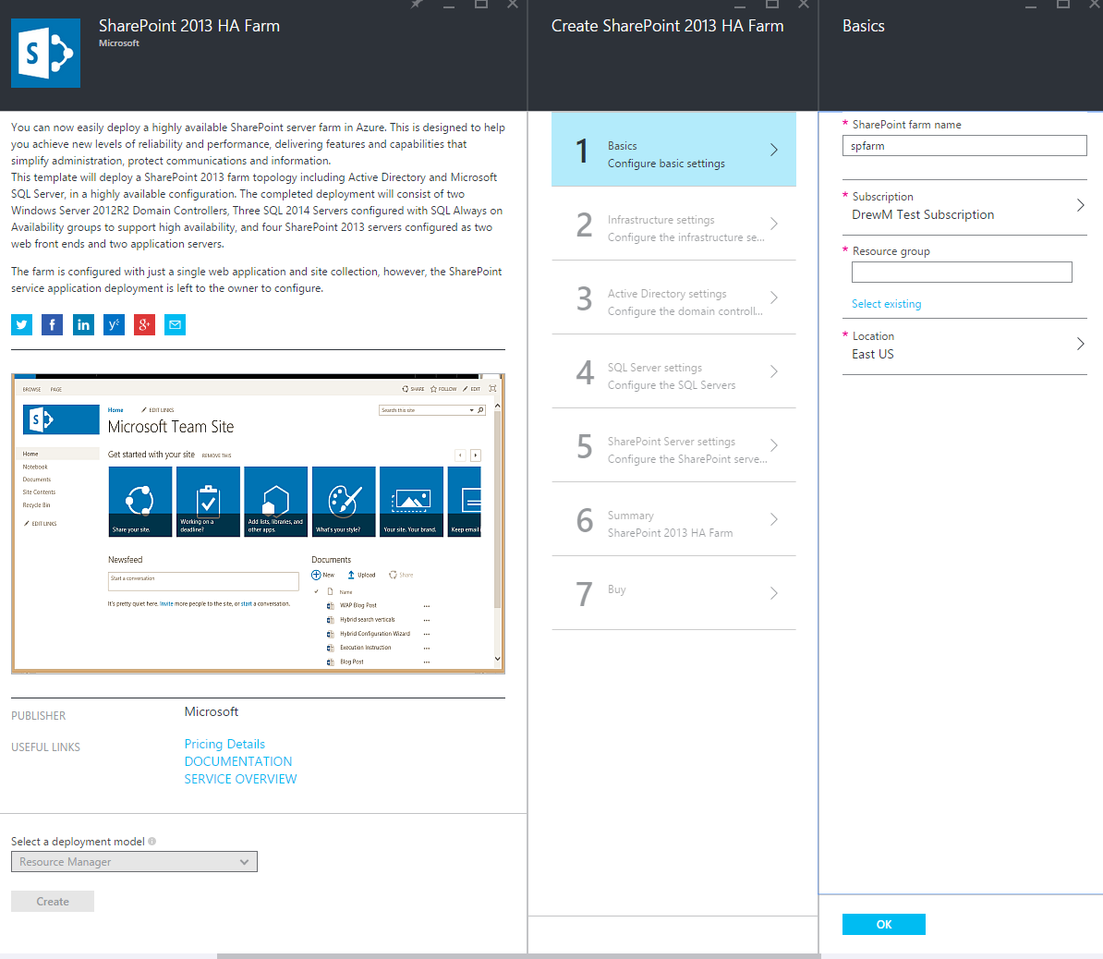
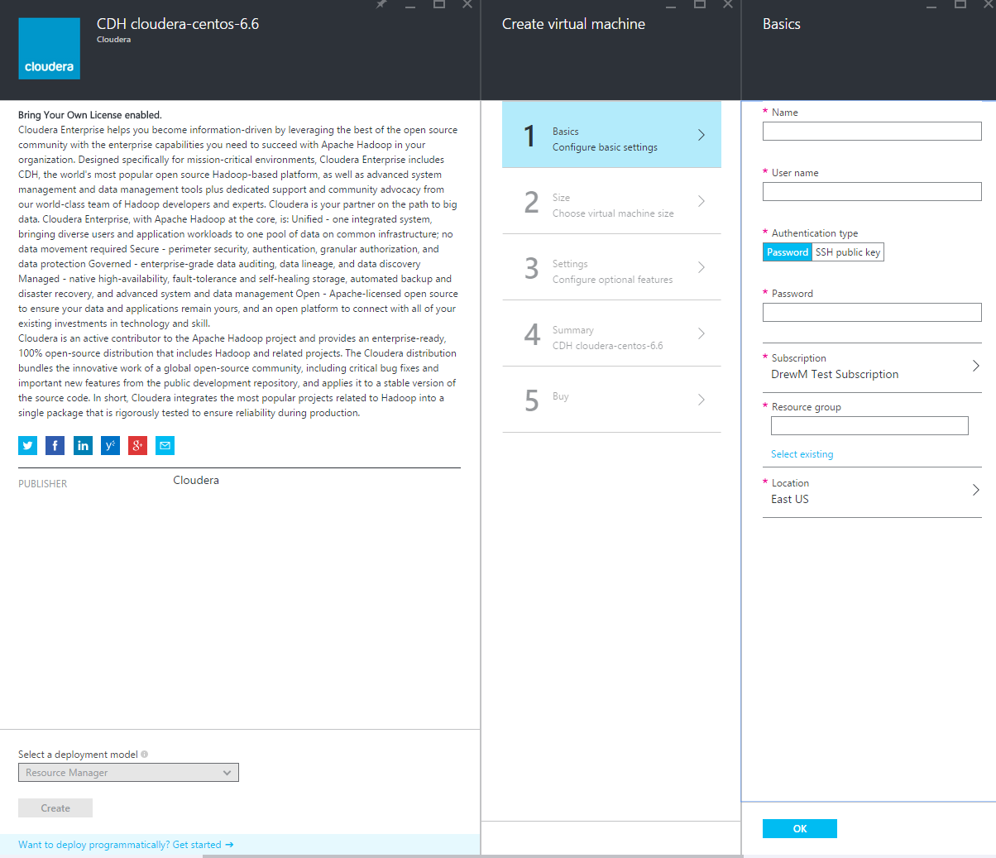
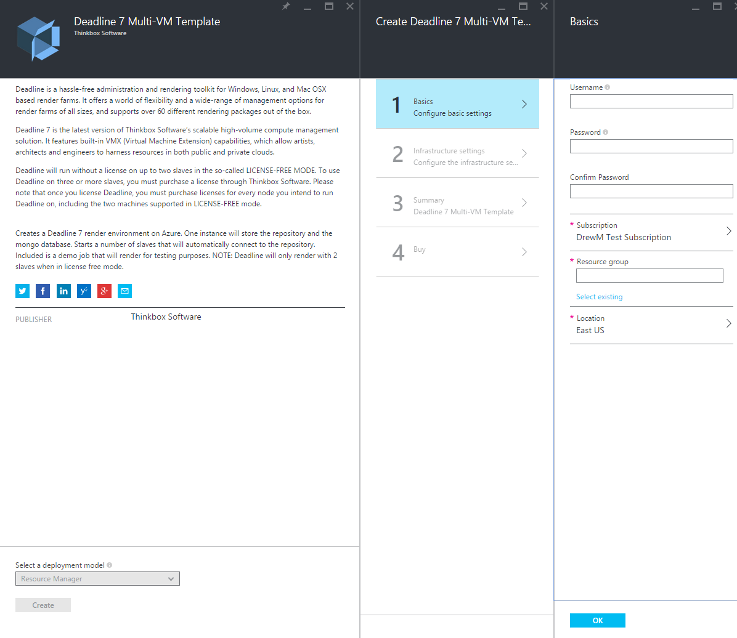
Azure Marketplace Multi-VM Templates

Slide 30
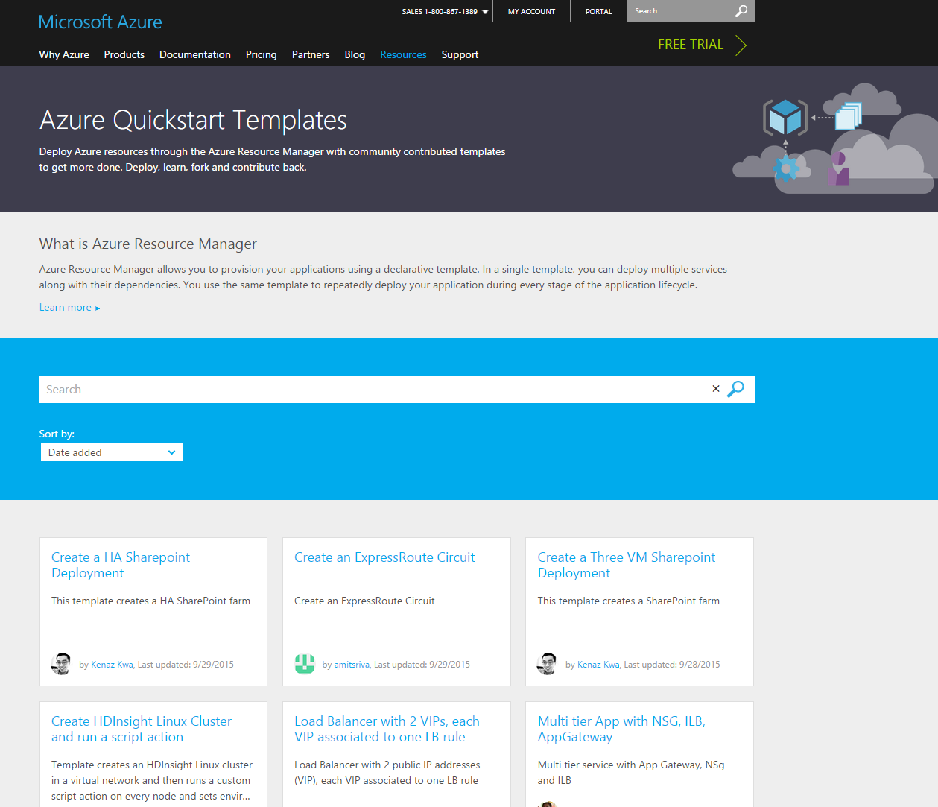
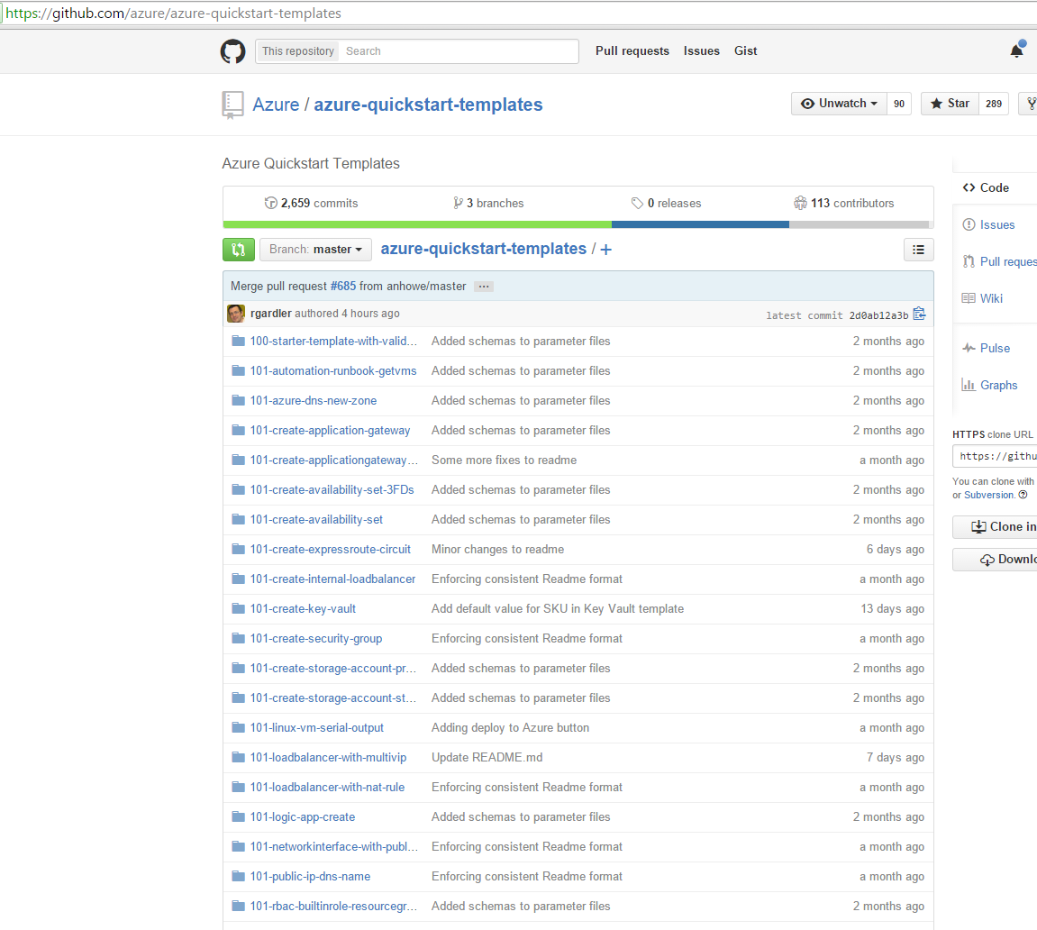
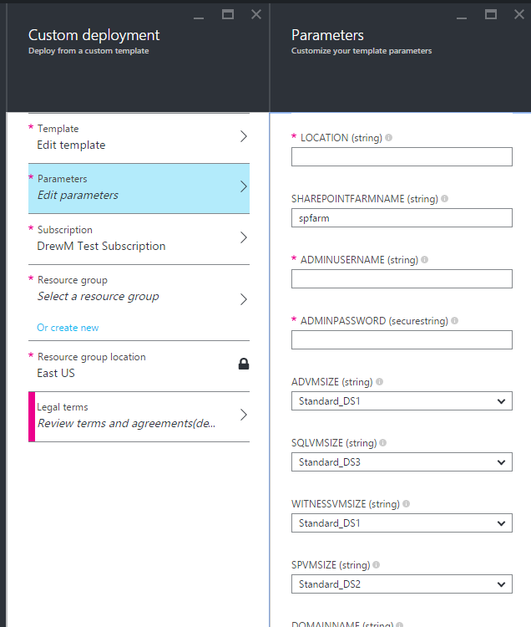
Community Quick-Start Templates
>170 community templates
Available through GitHub or Azure.com

Slide 31
Demo: Resource Manager Templates

Slide 32
Template debugging
Template validation
  Use tool with JSON validation (Examples: Visual Studio, Atom w/ JSONLint, or others )
  Leverage Test-AzureResourceGroupTemplate
Resource group logging
  Portal: Browse → Resource Groups → <Group> → Events
  PowerShell: Get-AzureResourceGroupLog
  Azure CLI: azure group log show
Azure Rest API Explorer
  View individual resources as they are deployed: https://resources.azure.com

Slide 33
What we discussed
VM (IaaS) Fundamentals
Network Fundamentals
Troubleshooting VMs
Azure Resource Manager & Templates
Many size options
Premium storage for IO intensive workloads
Hybrid options
Network security
Screenshots
Serial output
Reset password
RBAC
Tagging
Templates

